Slide 1


From Data Fusion to Knowledge Fusion
Xin Luna Dong, Google Inc.
9/13/2014 @ WISA’14

Slide 2
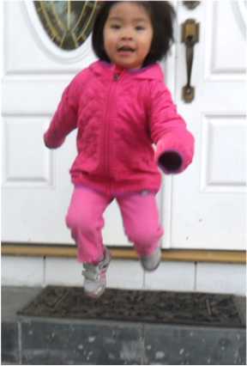

SONYA: A Big Project, A Fancy Machine, And A Cute Little Girl

Slide 3










Knowledge Is Power
Many Knowledge Bases (KB)

Slide 4
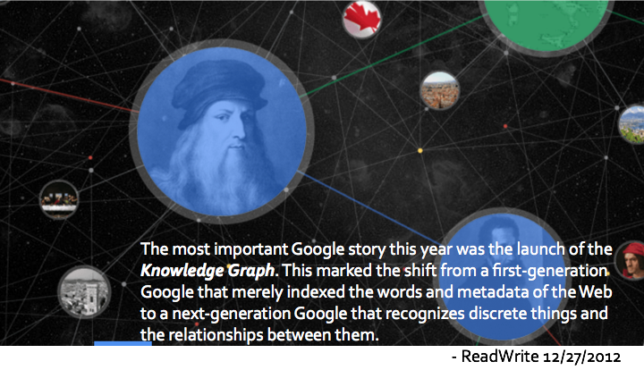
Google Knowledge Graph

Slide 5
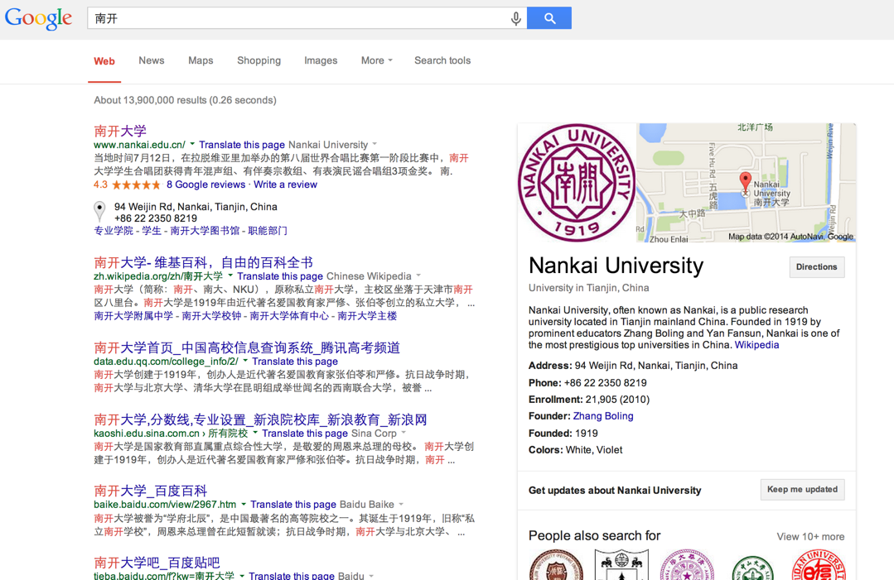
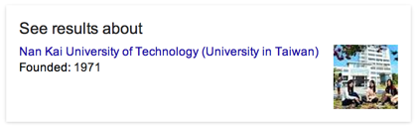
Using KG in Search

Slide 6
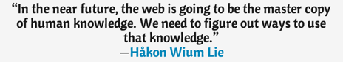
Expanding KG–
Extracting Knowledge from the Web
But–
KG requires 99% accuracy for knowledge
Web data is noisy and extraction is hard
How to balance coverage and accuracy?

Slide 7
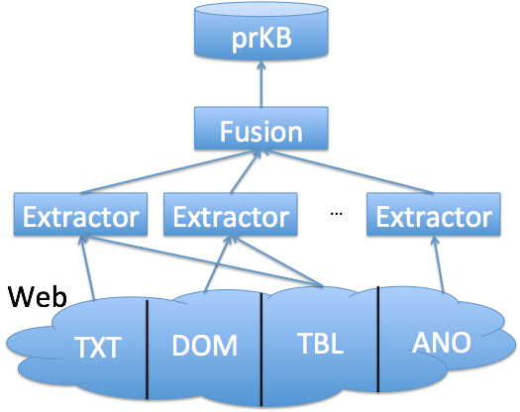
Knowledge Vault–
Building a Probabilistic KB
[VLDB’2014, Sigmod’2014, KDD’2014]

Slide 8
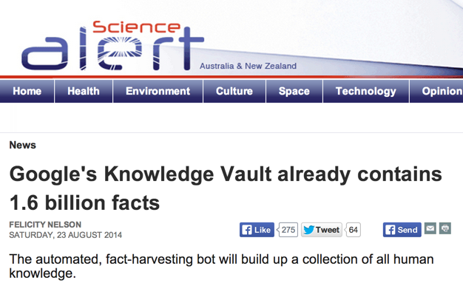

Slide 9
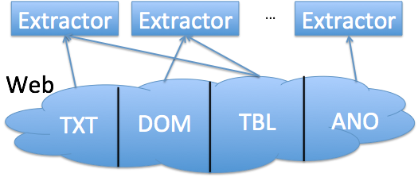
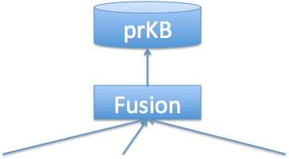

Outline
Knowledge extraction
Knowledge fusion
Interesting applications

Slide 10
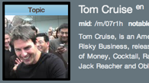
Knowledge Extraction I–Knowledge
Triple: (subject, predicate, object)
e.g., (Tom Cruise, date_of_birth, 7/3/1962)
Subject–a Freebase mid
e.g., /m/07r1h
Predicate–predefined in Freebase; e.g., people/person/date_of_birth
Object–a Freebase mid, a string, a number, or a date.

Slide 11
Statistics for Extracted Triples
A large knowledge base
Highly skewed data–fat heads, long tail
#Triples/type: 1–14M
#Triples/entity: 1–2M
As of 11/2013
#Triples | 1.6B (now 2.8B)
#Subjects (Entities) | 43M
#Types | 1.1K
#Predicates | 4.5K
#Objects | 102M
(location, organization, business)
(USA, UK, CA, NYC, TX)

Slide 12
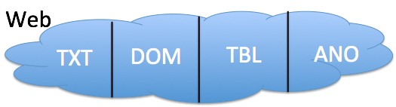
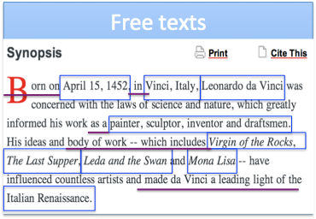
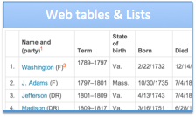
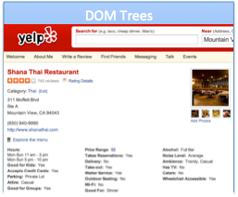
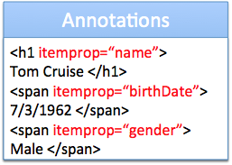

Knowledge Extraction II–Sources

Slide 13
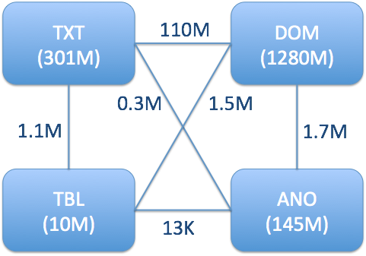
Statistics for Web Sources
1B+ Webpages over the Web
Contribution is skewed: 1- 50K
As of 11/2013

Slide 14

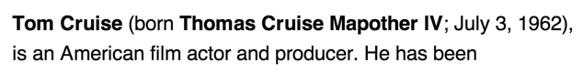
Knowledge Extraction III–Extractors
Three tasks (any order, maybe combined)
I. Triple identification
II. Entity linkage
III. Predicate linkage
/people/person/date_of_birth

Slide 15
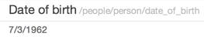
Knowledge Extraction III–Extractors
Texts/DOM: distant supervision
Web tables/lists: schema mapping
Annotations: semi-automatic mapping
Pattern 1: X “born” Y
→ (X, /people/person
/date_of_birth, Y)

Slide 16
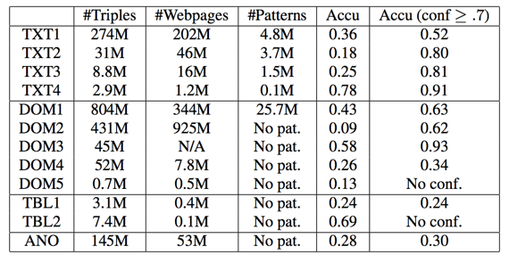
Statistics for Extractors
12 extractors; high variety
As of 11/2013

Slide 17
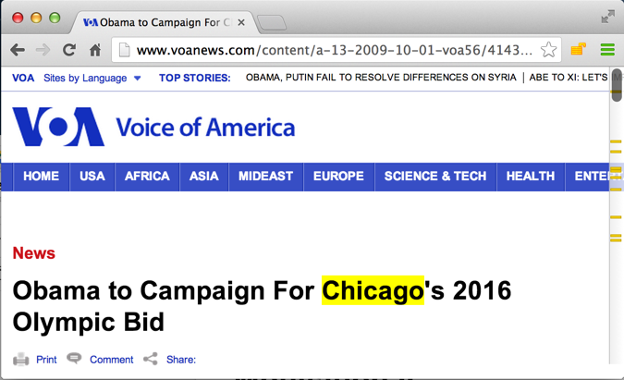
Errors Can Creep in at Every Stage
Extraction error: (Obama, nationality, Chicago)
9/2013

Slide 18
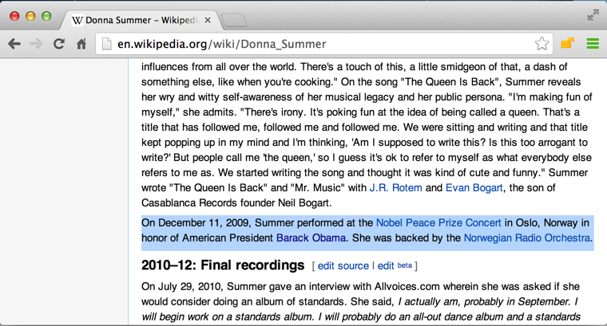
Errors Can Creep in at Every Stage
Reconciliation error: (Obama, nationality, North America)
American President Barack Obama
9/2013

Slide 19
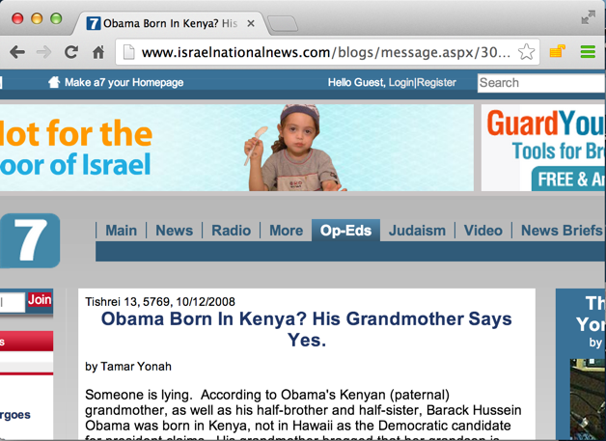
Errors Can Creep in at Every Stage
Source data error: (Obama, nationality, Kenya)
Obama born in Kenya
9/2013

Slide 20
Knowledge Extraction IV–Quality
Gold standard: Freebase
LCWA (Local Closed-World Assumption)
If (s,p,o) exists in FB: true
Otherwise,
If (s,p) exists in FB: false (Freebase knowledge is locally complete)
Otherwise: UNKNOWN
The gold standard contains about 40% of the triples

Slide 21
Statistics for Triple Correctness
Overall accuracy: 30%
Random sample on 25 false triples
Triple-identification errors: 11 (44%)
Entity-linkage errors: 11 (44%)
Predicate-linkage errors: 5 (20%)
Source-data errors: 1 (4%)

Slide 22
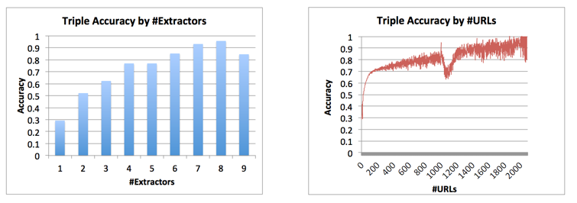
Statistics for Triple Correctness
As of 11/2013

Slide 23
Statistics for Extractors
12 extractors; high variety
As of 11/2013

Slide 24
Outline
Knowledge extraction
Knowledge fusion
Interesting applications

Slide 25
Goal: Judge Triple Correctness
Input: Knowledge triples and their provenances (i.e., which extractor extracts from which source)
Output: a probability in [0,1] for each triple
Probabilistic decisions
vs. deterministic decisions

Slide 26
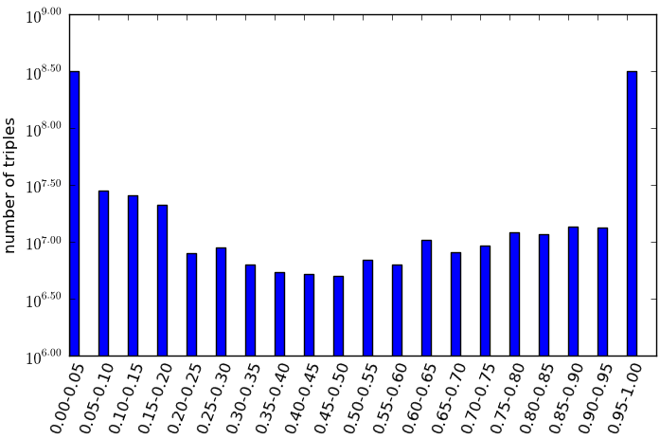
Usage of Probabilistic Knowledge
Negative training examples, and MANY EXCITING APPLICATIONS!!
Active learning, probabilistic inference, etc.
Upload to KG

Slide 27
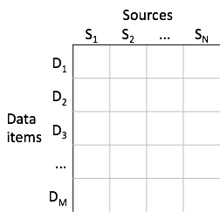
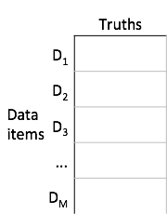
Data Fusion–Definition
Input Output

Slide 28
Data Fusion–Intuition
 | Src1 | Src2 | Src3
Jagadish | UM | ATT | UM
Dewitt | MSR | MSR | UW
Bernstein | MSR | MSR | MSR
Carey | UCI | ATT | BEA
Franklin | UCB | UCB | UMD

Slide 29
Data Fusion–Intuition
 | Src1 | Src2 | Src3
Jagadish | UM | ATT | UM
Dewitt | MSR | MSR | UW
Bernstein | MSR | MSR | MSR
Carey | UCI | ATT | BEA
Franklin | UCB | UCB | UMD
Voting--Trust the majority.

Slide 30
Data Fusion–Intuition
 | Src1 | Src2 | Src3
Jagadish | UM | ATT | UM
Dewitt | MSR | MSR | UW
Bernstein | MSR | MSR | MSR
Carey | UCI | ATT | BEA
Franklin | UCB | UCB | UMD

Slide 31
Data Fusion–Intuition
 | Src1 | Src2 | Src3
Jagadish | UM | ATT | UM
Dewitt | MSR | MSR | UW
Bernstein | MSR | MSR | MSR
Carey | UCI | ATT | BEA
Franklin | UCB | UCB | UMD
Quality-based--Give higher votes to more accurate sources.

Slide 32
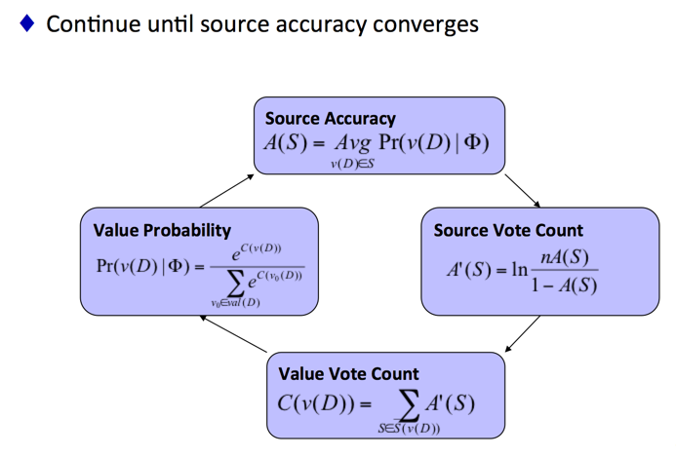
Data Fusion–A Bayesian Model
[Dong et al., VLDB’09]

Slide 33
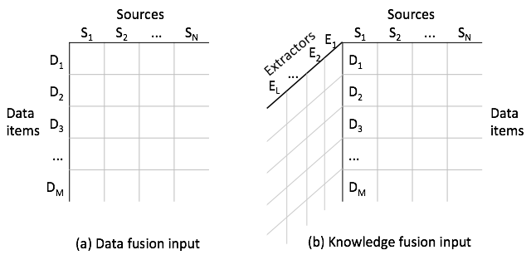
Knowledge Fusion Challenges
I. Input is three-dimensional
(S, P)

Slide 34
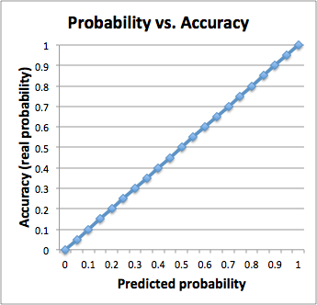
Knowledge Fusion Challenges
II. Output prs should be well-calibrated

Slide 35
Knowledge Fusion Challenges
III. Data are of Web-scale
Three orders of magnitude larger than currently published data-fusion applications
Size: 1.1TB
Sources: 170K→ 1B+
Data items: 400K→375M
Values: 18M→6.4B (1.6B unique)
Data are highly skewed
#Triples/Data-item: 1 - 2.7M
#Triples/Source: 1 - 50K

Slide 36
Knowledge Fusion Solutions
Treat each (URL, Extractor) as a whole (provenance) for accuracy evaluation
A series of refinements to improve probability calibration
MapReduce Based Framework
Sample for too big data items or provenances

Slide 37
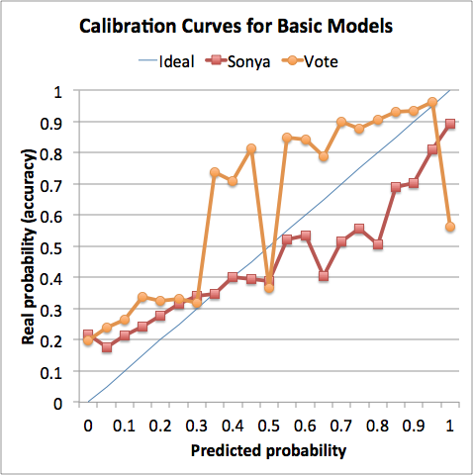
Basic Sonya Solution vs. Voting
The curve is closer to the ideal than naive voting

Slide 38
Refinements
Ignore low-coverage provenances
Granularity (URL->Site, Extractor->Pattern, Predicate)
Ignore low-accuracy provenances
Initiate provenance accuracy by FB
+I, II, III. Sonya+ : unsupervised
+IV. Sonya+(FB) : semi-supervised

Slide 39
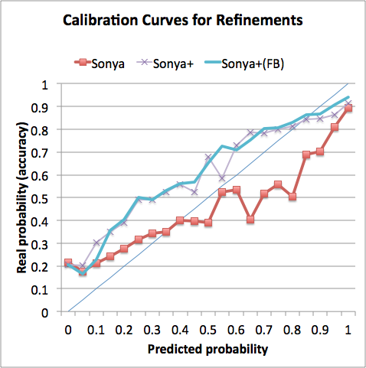
Calibration Curve
Higher accuracy
Smoother curve
Unsupervised methods very effective
Weighted deviation:
0.037→0.035→0.032

Slide 40
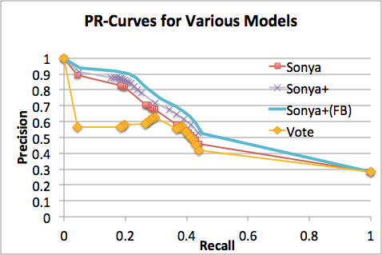
Precision-Recall Curve

Slide 41
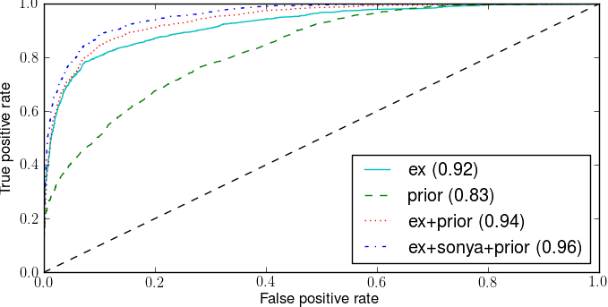
Other Fusion Techniques
Ex: Adaboost learning from extractions
Prior: (A, parent_of, C), (B, parent_of, C) → (A, spouse_of, B)

Slide 42
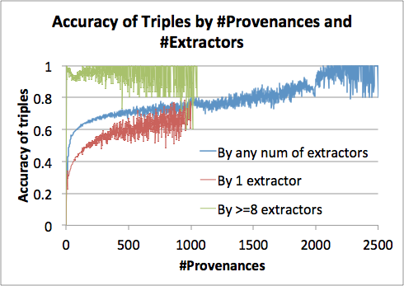
One Inherent Limitation
Cannot distinguish errors from extractor and from sources

Slide 43
Outline
Knowledge extraction
Knowledge fusion
Interesting applications

Slide 44
Usage of Probabilistic Knowledge
Source errors: trustworthiness evaluation
Extraction errors: data abnormality diagnosis
Negative training examples, and MANY EXCITING APPLICATIONS!!

Slide 45
Application I. A New Angle to Evaluate Web Source Quality
What we have now
Page Rank: links between Websites/Webpages
Log based: search log and click-through rate
Web spam
etc.

Slide 46
Popular Sources w. High Page Rank May Spread Gossip
Domain
www.eonline.com
perezhilton.com
radaronline.com
www.zimbio.com
mediatakeout.com
gawker.com
www.popsugar.com
www.people.com
www.tmz.com
www.fishwrapper.com
celebrity.yahoo.com
wonderwall.msn.com
hollywoodlife.com
www.wetpaint.com
14 out of 15 Gossip Websites have high page rank
http://www.ebizmba.com/articles/gossip-websites

Slide 47
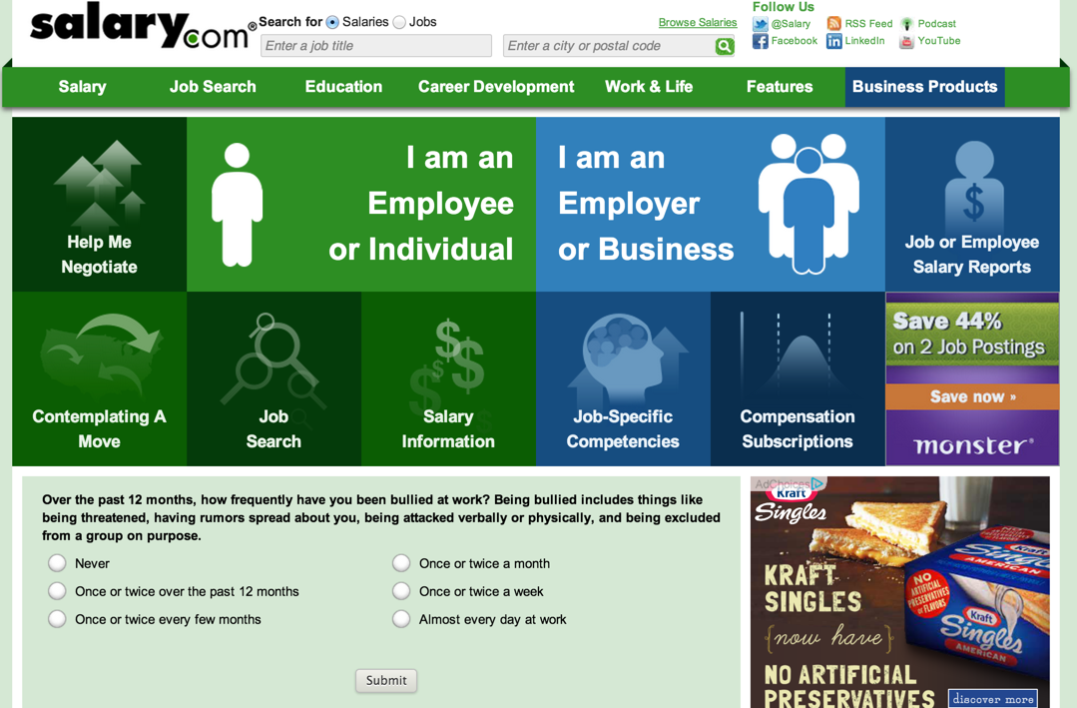
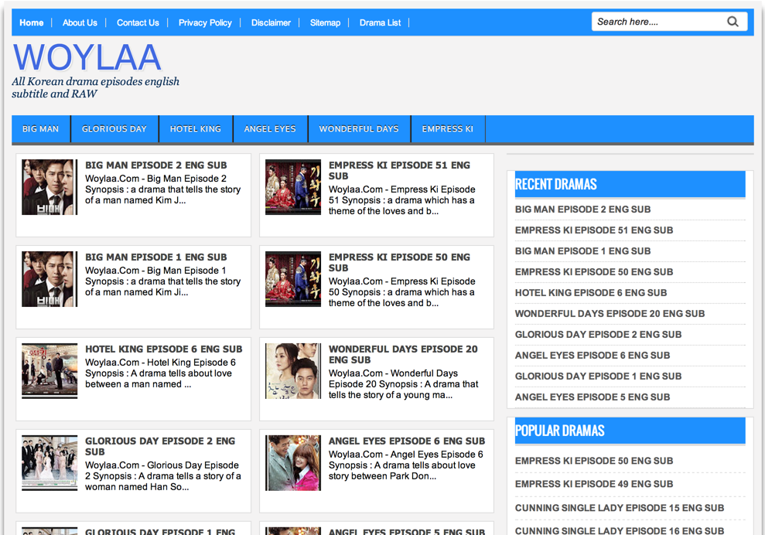
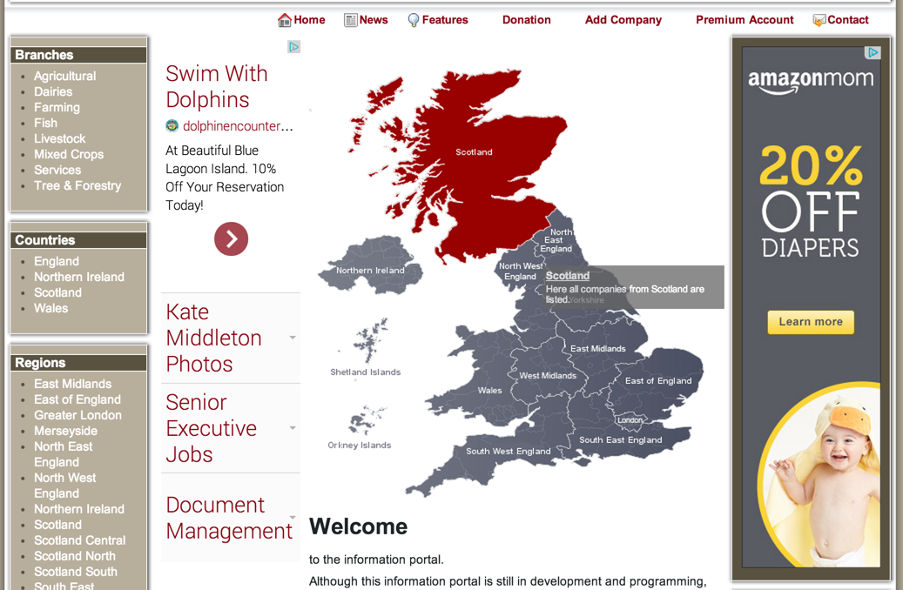
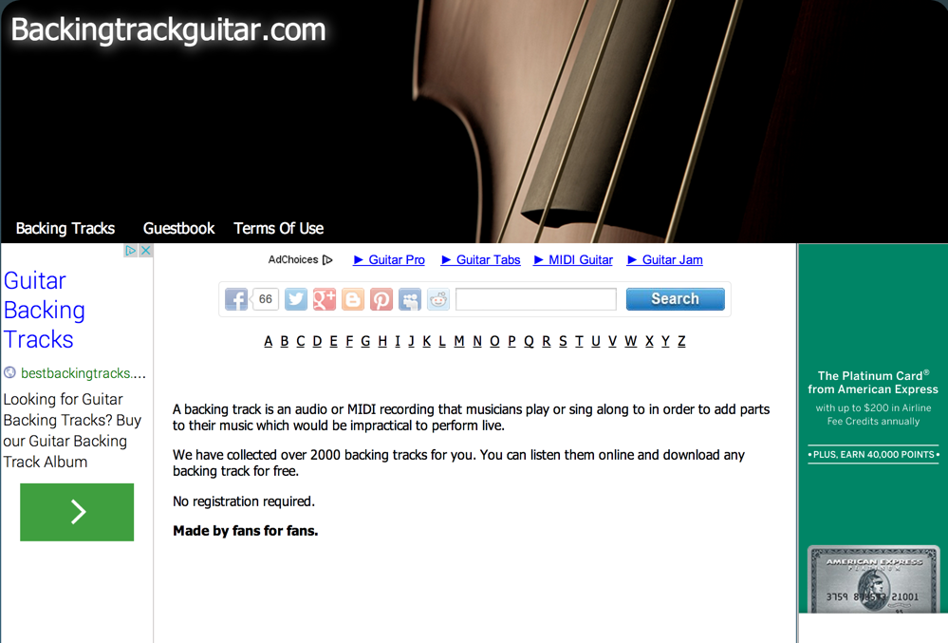
Tale Sources w. Low Page Rank May Provide Valuable Info

Slide 48
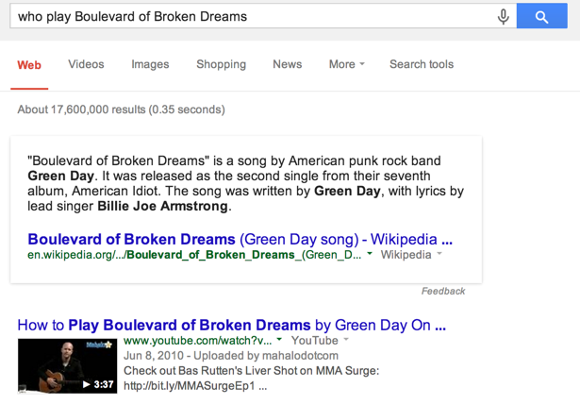
Tale Sources w. Low Page Rank May Provide Valuable Info
Good WebAnswer for an award-winning song

Slide 49
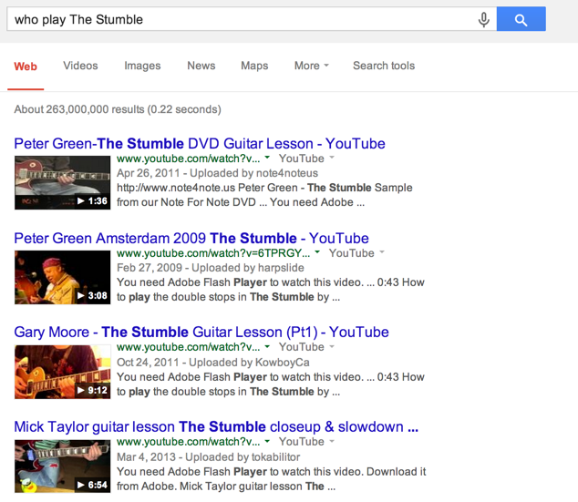
Tale Sources w. Low Page Rank May Provide Valuable Info
Missing WebAnswer for a not-so-popular song

Slide 50
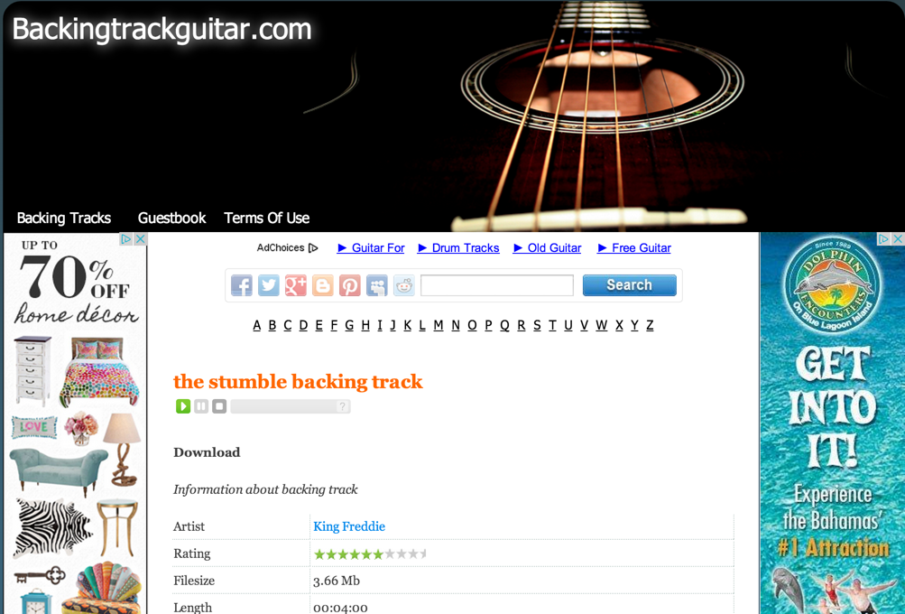
Tale Sources w. Low Page Rank May Provide Valuable Info
Very precise info on guitar players but low Page Rank

Slide 51
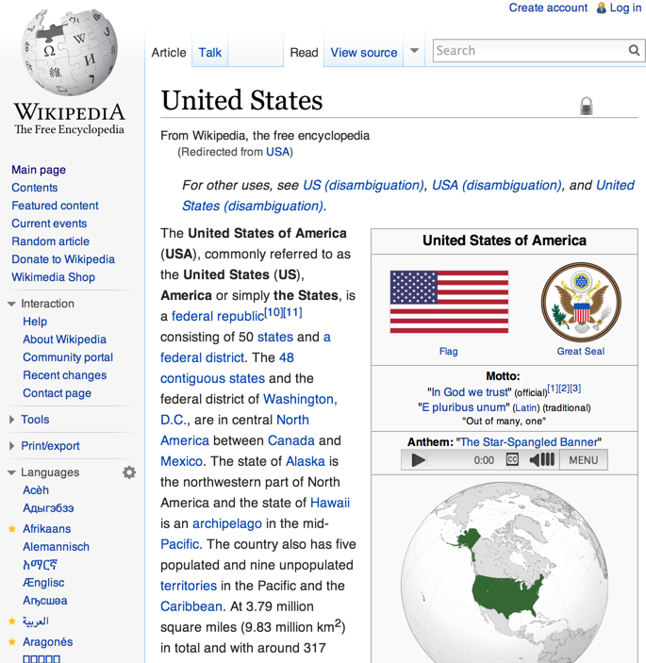
Application I. A New Angle to Evaluate Web Source Quality
Fact 1
Fact 2
Fact 3
Fact 4
Fact 5
Fact 6
Fact 7
Fact 8
Fact 9
Fact 10
...
✓
✓
✘
✓
✘
✓
✓
✓
✓
✘
...
Accu | 0.7

Slide 52
Application I. A New Angle to Evaluate Web Source Quality
How to decide if a triple is indeed claimed by the source instead of an extraction error?
✓
✓
✘
✓
✘
✓
✓
✓
✓
✘
...
Fact 1
Fact 2
Fact 3
Fact 4
Fact 5
Fact 6
Fact 7
Fact 8
Fact 9
Fact 10
...
1.0
0.9
0.3
0.8
0.4
0.8
0.9
1.0
0.7
0.2
...
Triple 1
Triple 2
Triple 3
Triple 4
Triple 5
Triple 6
Triple 7
Triple 8
Triple 9
Triple 10
...
Accu | 0.7

Slide 53
Application I. A New Angle to Evaluate Web Source Quality
Triple Corr | Extraction Corr
✓
✓
✘
✓
✘
✓
✓
✓
✓
✘
...
1.0
1.0
1.0
1.0
0.9
0.9
0.8
0.2
0.1
0.1
...
Fact 1
Fact 2
Fact 3
Fact 4
Fact 5
Fact 6
Fact 7
Fact 8
Fact 9
Fact 10
...
1.0
0.9
0.3
0.8
0.4
0.8
0.9
1.0
0.7
0.2
...
Triple 1
Triple 2
Triple 3
Triple 4
Triple 5
Triple 6
Triple 7
Triple 8
Triple 9
Triple 10
...
Accu | 0.7
Accu | 0.73

Slide 54
Sonya Trustworthiness Score
Domain | #Triples | Sonya Score
www.eonline.com | 12,871 | 0.363
perezhilton.com | 46,912 | 0.427
radaronline.com | 3,530 | 0.489
www.zimbio.com | 2,464,452 | 0.530
mediatakeout.com | 131 | 0.531
gawker.com | 6,055 | 0.567
www.popsugar.com | 1,805 | 0.576
www.people.com | 16,886 | 0.585
www.tmz.com | 8,149 | 0.621
www.fishwrapper.com | 14 | 0.622
celebrity.yahoo.com | 11,187 | 0.677
wonderwall.msn.com | 2,524 | 0.684
hollywoodlife.com | 4,536 | 0.689
www.wetpaint.com | 19,284 | 0.730
Many gossip Web sites DO provide quite a lot of wrong factual information

Slide 55
Application II. Provide An X-Ray for Extracted Data
Goal: Help users analyze errors, changes and abnormalities in data
Intuitions: cluster errors by features and return clusters with top error rates

Slide 56
Application II. Provide An X-Ray for Extracted Data
Cluster I.
Feature: (besoccor.com, date_of_birth, 1986_02_18)
#Triples: 630; Errs: 100%
Reason: default value
Cluster 2.
Feature: (ExtractorX, pred: namesakes, obj:the county)
#Triples: 4878; Errs: 99.8%
E.g., [Salmon P. Chase, namesakes, The County]
Contexts: The county was named for Salmon P. Chase, former senator and govenor of Ohio
Reason: Unresolved coreference

Slide 57
TAKE AWAYS
A new area--Knowledge Fusion
We can solve KF problem fairly well by adapting DF methods
Many interesting future directions for KF!
Many exciting applications for the prKB!!

Slide 58






Acknowledgement
Evgeniy Gabrilovich (Manager, need to say anything?)
Geremy Heitz (Strongest supporter)
Wilko Horn (Strictest code reviewer)
Kevin Murphy (Intelligent consultant)
Shaohua Sun (Critical representer to the outside world)
Wei Zhang (Fearless explorer of new ideas)

Slide 59
THANK YOU!
Questions?

Slide 60
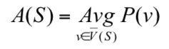
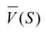
Data Fusion–A Bayesian Model
[Dong et al., VLDB’09]
Q1. How to compute source accuracy?
Source Accuracy: A(S)
- values provided by S
P(v) - pr of value v being true

Slide 61
Data Fusion–A Bayesian Model
[Dong et al., VLDB’09]
Q2. How to leverage accuracy in voting?
Input:
-Data item D
-Dom(D)={v₀,v₁,…,v_{n}}
-Observation Ф on D
Output:
Pr(v_{i} true|Ф) for each i=0,…, n (sum up to 1)
According to the Bayes Rule, we need to know Pr(Ф|v_{i} true)
Assuming independence of sources, we need to know
Pr(Ф(S) |v_{i} true)
If S provides v_{i} : Pr(Ф(S) |v_{i} true) =A(S)
If S does not provide v_{i} : Pr(Ф(S) |v_{i} true) =(1-A(S))/n

Slide 62
Data Fusion–A Bayesian Model
[Dong et al., VLDB’09]
Q3. How to handle interdependence between source accuracy and value pr?

Slide 63
Knowledge Fusion Solutions
Treat each (URL, Extractor) as a whole (provenance) for accuracy evaluation
A series of refinements to improve probability calibration
MapReduce Based Framework
Terminate in 5 rounds
Sample for too big data items or provenances

Slide 64
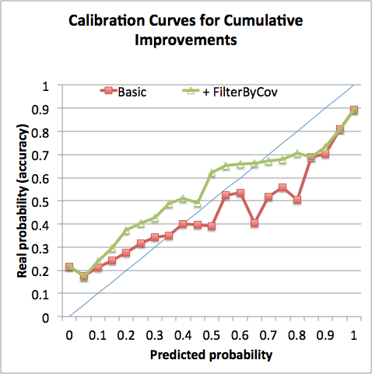
Refinement I. Ignore Low-Coverage Provenances
Smoother curve
Coverage: 1→ .918

Slide 65
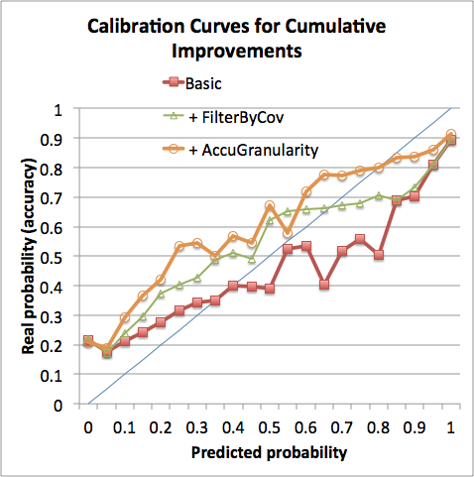
Refinement II. Granularity (URL->Site, Extractor->Pattern, Predicate)
Much higher accuracy
Much higher coverage
Coverage:.918→.993

Slide 66
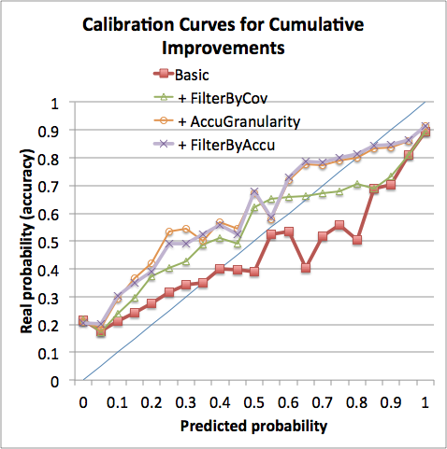
Refinement III. Ignore Low-Accuracy Provenances
Closer to ideal curve

Slide 67
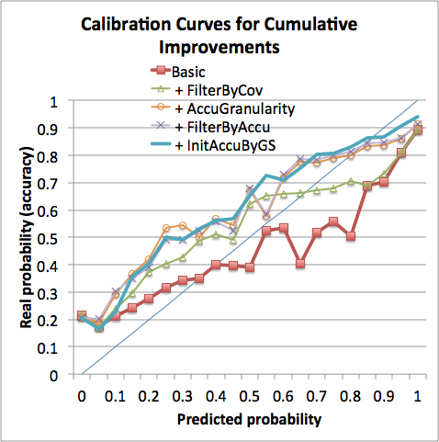
Refinement IV. Initiate Provenance Accuracy by FB
Closer to ideal curve
Smoother curve
Coverage:.993→.994

Slide 68
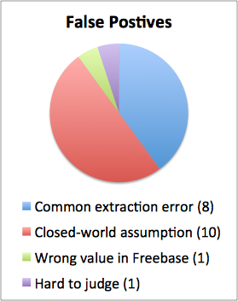
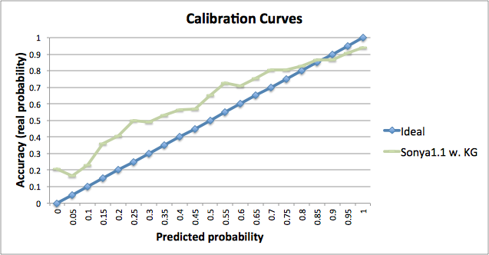

Analysis of Errors
Future Directions!!!

Slide 69
Result I. Extraction and Triple Correctness
Example 1. (Obama, nationality, ?)
(Obama, nationality, Bolivarianism) (many many such subjects)
3 extractions (Pr_provide=0.01)http://mathaba.net/news/?x=631316http://www.laht.com/article.asp?ArticleId=329187&CategoryId=10717http://www.iamericas.org/en/about-ioa/presidents-corner
Pr_true=0

Slide 70
Result I. Extraction and Triple Correctness
Example 1. (Obama, nationality, ?)
(Obama, nationality, Kenya)
2087 extractions:
Example of a correct extraction (Pr_provide=0.792):
http://beforeitsnews.com/obama-birthplace-controversy/2013/04/alabama-supreme-court-chief-justice-roy-moore-to-preside-over-obama-eligibility-case-2458624.html
Example of a wrong extraction (Pr_provide=0.130):http://www.monitor.co.ug/News/National/US+will+respect+winner+of+Kenya+election++Obama+says/-/688334/1685814/-/ksxagx/-/index.html
Pr_true=0 (not enough support)

Slide 71

Result I. Extraction and Triple Correctness
Example 1. (Obama, nationality, ?)
(Obama, nationality, USA)
2481 extractions:
Example of a correct extraction (Pr_provide=0.999):
http://www.dogonews.com/2009/10/9/a-nobel-prize-for-our-awesome-president
Example of a wrong extraction (Pr_provide=0.261):http://blogs.telegraph.co.uk/news/timstanley/100169248/barack-obamas-life-story-contains-myth-not-truth-says-biographer-so-why-did-the-media-report-it-as-truth/
Pr_true=1

Slide 72


Sonya Trustworthiness Score
Example for (URL, Predicate) URL: https://ibirthdayworld.blogspot.com/2010/03/celebrity-birthdays-on-march-22.html
Predicate: date_of_birth
- #Facts = 42; Trustworthiness = 0.95

Slide 73

Sonya Trustworthiness Score

Slide 74

Sonya Trustworthiness Score
Example for (URL, Predicate) URL: https://ibirthdayworld.blogspot.com/2010/03/celebrity-birthdays-on-march-22.html
Predicate: date_of_birth
- #Facts = 42; Trustworthiness = 0.95
- Mistake: Anne Hyde (the URL says: 3/22/1638; Wiki/KG says: 3/12/1637)

Slide 75


Outline
Knowledge extraction
Knowledge fusion
Interesting applications
Future directions

Slide 76

Future Directions: Remove the Assumptions One by One
Assumption I. Independence between pairs of provenances (i.e., (URL, extractor))

Slide 77

Future Directions: Remove the Assumptions One by One
Assumption II. Single true object for each (sub, pred)

Slide 78

Future Directions: Remove the Assumptions One by One
Assumption III. Extractions are deterministic

Slide 79
Future Directions: Remove the Assumptions One by One
Assumption IV. Values (objects) are categorical
Assumption V. We have enough data to judge accuracy of each source
Assumption VI. Local closed-world assumption in evaluation

Slide 80

Future Directions: Remove the Assumptions One by One
Assumption VII. Global closed-world assumption--consider only existing entities and predicates in FB
WE NEED SOMETHING NEW!!!

